Slide 1
NATIONWIDE SOLAR ECLIPSE PROJECT
DAKOTA BURKLUND

Slide 2

Overview
Who we are
Mission
Objectives
Systems
Ground Station Assembly
Ground Station Software
Ground Station Errors
Solutions to Errors
Photo Credit: MSU

Slide 3


Who we are
Joint project
  Arizona State University
  Embry-Riddle Aeronautical University
5 NASA Space Grant Interns
2 Project managers
More than 4 active volunteers
Photo Credit: ASU
Photo Credit: ERAU

Slide 4
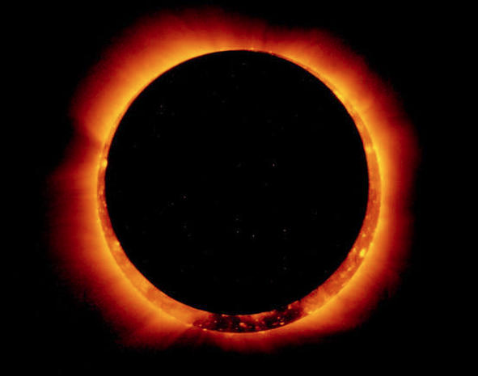
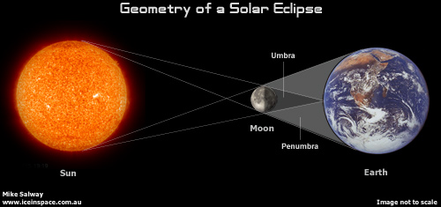
Mission - What is a Solar Eclipse?
Moon’s shadow partially covers the Earth
Approximately 18 months apart
Next total eclipse Aug 21st
Photo Credit: CBS News
Photo Credit: iceinspace

Slide 5
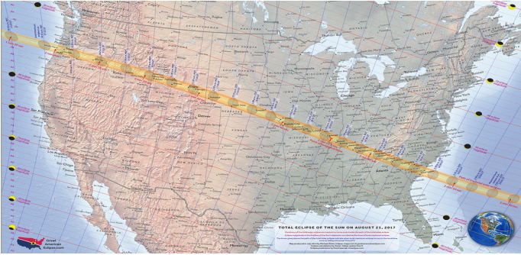
Mission - Concept
Student lead teams across the United States
Each team covers an assigned area of the path of totality
Continuous video of the Moon’s shadow
Live stream video for the anyone to see
Allow students to practice Engineering skills
Photo Credit: MSU

Slide 6
Mission - Who our Mission Affects
Students aiding in the mission
Those unable to visit the eclipse area
Solar eclipse researchers

Slide 7
Objectives
Primary Objective
  Live stream video of solar eclipse
Secondary Objectives
  Collect HD video
  Collect HD images
  Collect scientific data of solar eclipse

Slide 8
Systems - Overview
Payloads
  GPS beacons
  Live stream video payload
  HD image and video payload
  Scientific payload
  Cut-down payload
Ground Stations
  Primary - student built ground station
  Secondary - Arizona Near Space Research ground station

Slide 9
Systems - Ground Station Differences
Primary – Student built
  Auto-targeting
  Real-time station updates
  Low weight limit
  Relatively untested system
  One piece setup
Secondary – Arizona Near Space Research
  Manual targeting
  High weight limit
  Successfully utilized for numerous missions

Slide 10
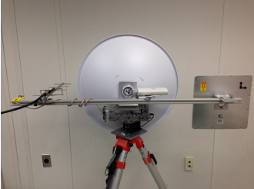
Ground Station Assembly - Overview
Small lightweight design
Tri-pod base
Single 5.8 GHz dish
Spar across rear for additional antennas
Arduino with GPS beacon
  Inertial Measurement Unit (IMU)
Servos
  Servo controller
Photo Credit: MSU

Slide 11
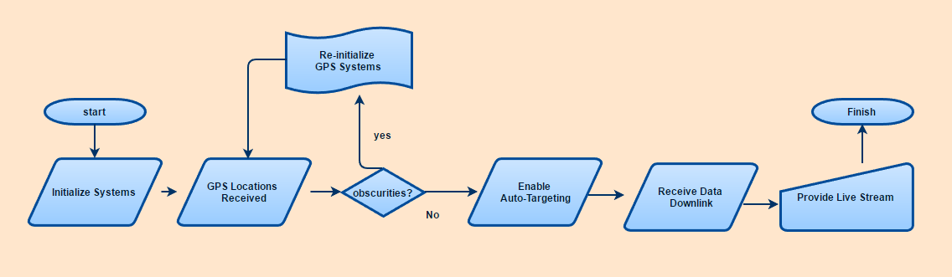
Ground Station Assembly - Operation
Flowchart for Order of Ops

Slide 12
Ground Station Software - Arduino
Collection
  GPS location of ground station
  IMU’s accelerometer, gyroscope, and magnetometer data
Sends data to laptop to be parsed

Slide 13
Ground Station Software - Python Parsing
Input string from GPS
  Arduino
    $GSIMU,31.34567,-91.32456,80,1,12,0.0,0.0,0.0,3,3,3,3,1,...,*,
  APRS
    N7ERU-11>APTT4,WIDE2-1:/194444h3024.75N/09110.72WO000/000/A=000131/HiBall
GPS location extracted from strings
IMU calibration data extracted from arduino

Slide 14
Ground Station Software - Python GUI
Outputs values for operator to check
Calibration of station
Calibration of IMU
Enabling/Disabling of auto-targeting
Allows for manual targeting and re-positioning

Slide 15
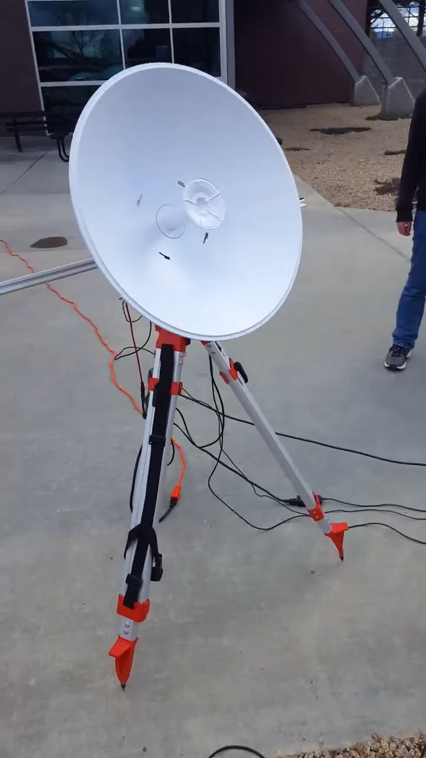
Ground Station Software - Python Tracking
Auto-targeting from ground station position to balloon
IMU provides attitude determination and rotation estimation
Data downlink on postive lock
Live stream is uploaded via laptop

Slide 16
Ground Station Errors
Calibration of IMU
  Unable to calibrate IMU within the GUI
Slow rotation of servos
  Software is causing a step movement
  Desired movement is a continuous sweep
APRS system
  APRS packets not received due to range from ground station
  Volume control for receiver causes the computer to miss packets

Slide 17
Solutions to Errors
IMU calibration
  Work through each line of code ensuring quality
    GUI code
    Calibration code
Slow rotation of servos
  Work through each line of code ensuring quality
    Auto-targeting code
    Manual targeting code
    Servo control code
APRS system
  Increase gain of ground station antenna
  No known solution for volume control

Slide 18
Summarization
Who we are:
  Arizona State University & Embry-Riddle Aeronautical University joint project
Mission:
  Share the solar eclipse with the world
Objectives:
  Live Stream the solar eclipse
Systems
  Developed to meet our objectives and mission
Ground station assembly
Ground station software
Ground station errors
Solutions to errors

Slide 19
Acknowledgments
Prof. Jack Crabtree
Gene Swiech
Michael Fusco
Robert Velarde
Dr. Gary Yale
Dr. Heather Marriott
Jim Weber
Michael Stewart
Braden Johel
Steven Buck
Montana State Univeristy

Slide 20
Questions
Dakota Burklund
Project Lead
(512) 738-2740
burklund@my.erau.edu

Slide 21
References
Montana State University (July 2016). PowerPoint Presentation, “MSGC BOREALIS and the NASA Space Grant 2017 Eclipse Ballooning Project”
CBS News (March 2017). Online Journal, “The most famous solar eclipses in history”
Australian Amateur Astronomy (March 2017). Online Forum

